Slide 1
GA Project 3
Nlp classification for
ad targeting
r/codingbootcamp vs r/csmAJOR
Mary-anne, rifqi, shawn, ting wei, wei zhe
Notes:
Hi good morning everyone. Today we’ll be presenting on using natural language processing to build classification models that help with ad targeting.

Slide 2
Contents
Background
Problem Statement
Workflow
Data Cleaning
EDA
Modelling
Limitations/Moving Forward
Recommendations
Conclusion
Notes:
Future work could involve scraping other platforms, channels, etc?

Slide 3




BACKGROUND
There is increased competition in the space for coding bootcamps.
Notes:
For context, as you all know, there has been increased competition in the coding bootcamp space in recent years, with several new providers popping up. Some of the more notable ones you might have heard of include hack reactor, le wagon, vertical institute, and rocket academy.

Slide 4



BACKGROUND
There is an increased competition in the space for coding bootcamps.
If no action is taken, General Assembly may face…
Decline in market share
Lower marketing ROI
Poorer Lead Generation
Notes:
and with that, if no action is taken, General assembly might face a decline in market share, poorer returns on marketing expenditure, or lower enrollment rates in future courses.

Slide 5


BACKGROUND
Better identify the online presence of a bootcamp seeker as opposed to that of a computer science major to aid in targeted advertising.
Considering the two topics have quite a bit in common, efforts to further segregate the two could yield better advertising ROI.
MARKETING TEAM
Notes:
But don’t worry, that’s why we’re here to provide some insights and hopefully help the marketing team out.
For starters, we understand that GA marketing has since been trying to figure out how to better identify the online persona of a bootcamp seeker as opposed to that of a computer science major to aid in narrowing down targets further.
Considering the two topics have quite a bit in common, efforts to segregate these two groups could yield better returns on advertising investment.

Slide 6
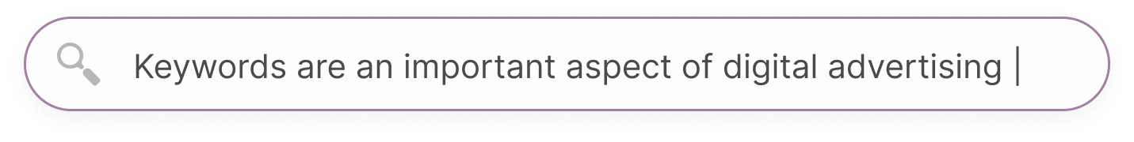
https://www.keywordsrock.com ⁞
Keywords allow for targeted strategies at all levels of the marketing funnel
Keywords guide marketing teams on the sort of advertising content that is required.
E.g. Google ads, one of the most effective platforms for generating leads and sales works well due to its ability to target users with high buying intent based on the keywords they use.
SEO Keywords ᐧ Google Ad ᐧ General Assembly ᐧ Coding Bootcamps
Notes:
And we know that keywords are a really important aspect when it comes to digital advertising as they allow for targeted strategies at all levels of the marketing funnel.

Slide 7
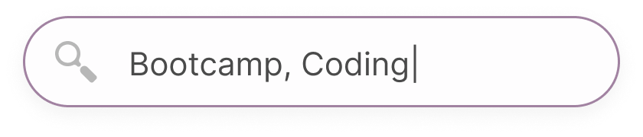
Google Search
I’m Feeling Lucky
Current classifying model using straightforward keywords such as ‘bootcamp’ and ‘coding’ yields around 79% accuracy.
Notes:
Now, our current baseline model that relies purely on obvious keywords such as ‘coding’ and ‘bootcamp’ yields only about 79% accuracy on this segregation task.

Slide 8

Problem Statement
Build a model with >90% accuracy that helps to identify between those who are looking for bootcamp style learning vs computer science majors/prospective cs students based on the words they use online.

Slide 9
Workflow
Pre- process
Scrape
analyse
model
evaluate
Notes:
We go about diong that by first Getting the data through scraping -> preprocessing (cleaning, transforming the data into a usable form for machine learning) -> Exploratory data analysis to identify interesting trends/ findings -> Building and tuning models -> Evaluation using metrics to determine production model.

Slide 10
Workflow
Pre- process
Scrape
analyse
model
evaluate
Notes:
Followed by preprocessing which includes cleaning and transforming the data into a usable form for machine learning -> Exploratory data analysis to identify interesting trends/ findings -> Building and tuning models -> Evaluation using metrics to determine production model.

Slide 11
Workflow
Pre- process
Scrape
analyse
model
evaluate
Notes:
We then perform Exploratory data analysis to identify interesting trends/ findings -> Building and tuning models -> Evaluation using metrics to determine production model.

Slide 12
Workflow
Pre- process
Scrape
analyse
model
evaluate
Notes:
Go on to build and tune machine learning models -> Evaluation using metrics to determine production model.

Slide 13
Workflow
Pre- process
Scrape
analyse
model
evaluate
Notes:
And finally, Evaluate the models using certain metrics to determine the best performing one for production. Next up is Rifqi, who will bring us through the first 2 steps in more detail.

Slide 14

What methods are we using to clean?
Web Scraping
Remove Null/Duplicate values
Remove punctuations
Notes:
Thanks Ting Wei, so as Ting Wei mentioned data gathering and cleaning are the very first steps in the workflow. I feel that these steps are extremely important because you would always want a clean data to work with. And what is a clean data? Let’s find out… so what are the methods are we using to clean? We have…(read the numbered points)
Web scraping
Removing null/duplicate values
Removing punctuations
Tokenization
Remove stopwords
Lemmatize

Slide 15
What methods are we using to clean?
Tokenization
Remove stopwords
Stem / Lemmatize
Notes:
Thanks Ting Wei, so as Ting Wei mentioned data gathering and cleaning are the very first steps in the workflow. I feel that these steps are extremely important because you would always want a clean data to work with. And what is a clean data? Let’s find out… so what are the methods are we using to clean? We have…(read the numbered points)
Web scraping
Removing null/duplicate values
Removing punctuations
Tokenization
Remove stopwords
Lemmatize

Slide 16
Web scraping
Reddit API vs Pushshift API
Easier retrieving data
5 times greater object limit
Notes:
Why do ppl; use pushshift api instead of the official reddit api? In short, pushshift makes it much easier for researchers to query and retrieve historical reddit data, it provides a full-text search against comments and submissions. Pushshift has a size limit five times greater than reddit 100 object limit. This means it is able to retrieve 5 times more data than reddits api. Pushshift enables the end user to quickly ingest large amounts of data. For us data scientists, we would always prefer to get large amounts of data at the shortest amount of time. I think we can all agree that time is money.

Slide 17

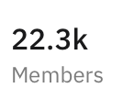

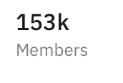
Where do we scrape from?
Notes:
We will be scraping from these 2 subreddits. So for you to access to a subreddit, you have to type R followed by the forward slash and then the name of the subreddit. So as you can see we will be scraping from the coding bootcamp and cs majors subreddits. Coding bootcamp as 22.3k members and cs majors has 153k members. From here you can roughly tell the size or amount of posts each subreddit has.

Slide 18
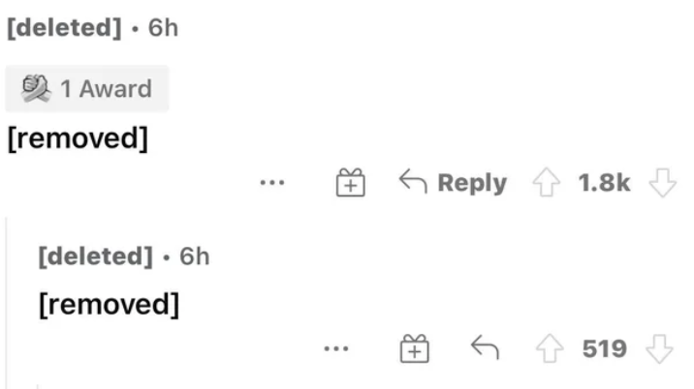
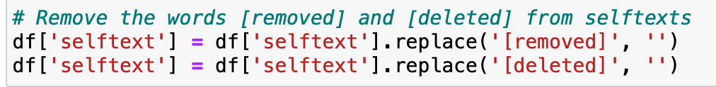
REmoved & deleted
Removed & Deleted posts are not beneficial to our case
They are replaced with an empty string

Slide 19
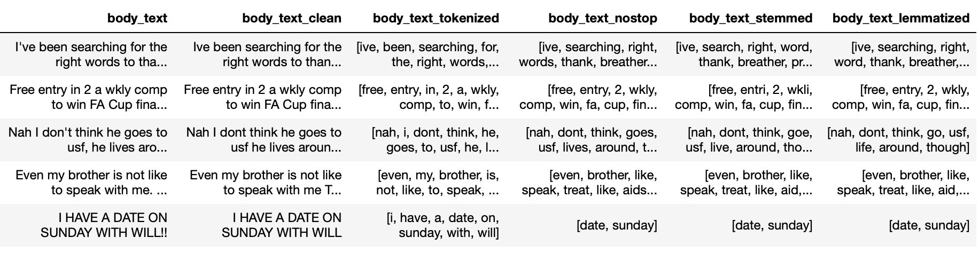
Remove punctuation & Tokenization
Removed Punctuation
Tokenization

Slide 20
Lemmatization
01.
02.
03.
What?
How?
Why?
Notes:
What is lemmatization?
How is lemmatization different from stemming?
Why did we pick lemmatization?

Slide 21
eda

Slide 22
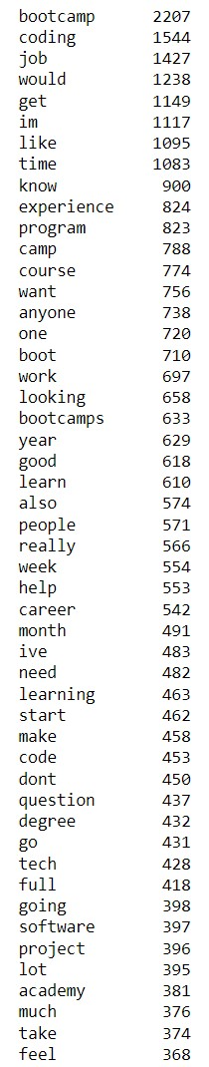
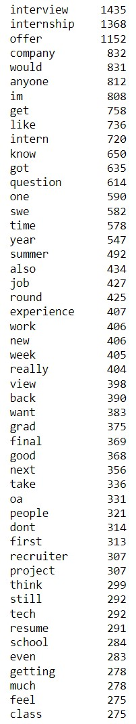
EDA : REMOVING ADDITIONAL STOPWORDS
Coding Bootcamp top 50 words
CS Majors top 50 words

Slide 23
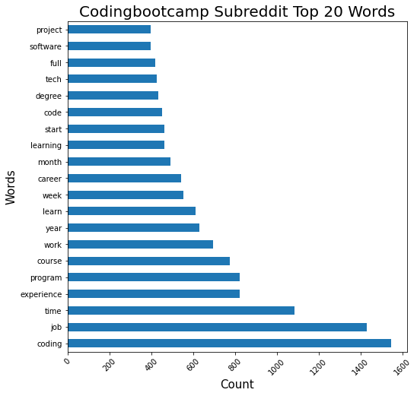
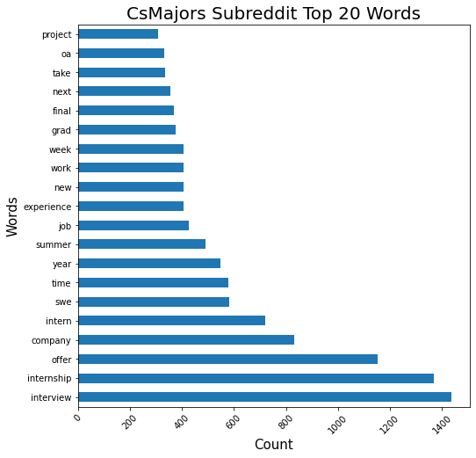
EDA : TOP 20 WORDS

Slide 24
EDA : TOP 20 WORDS - SIMILARITIES

Slide 25
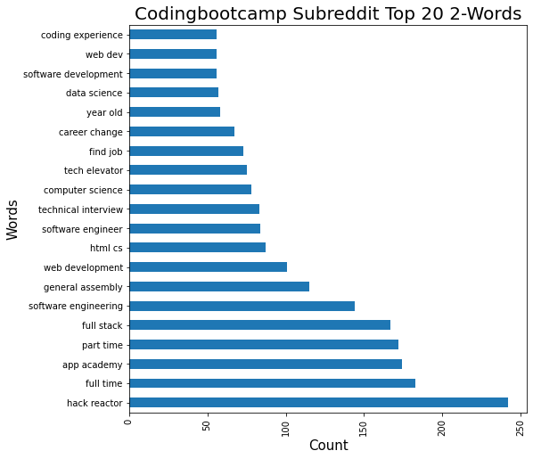
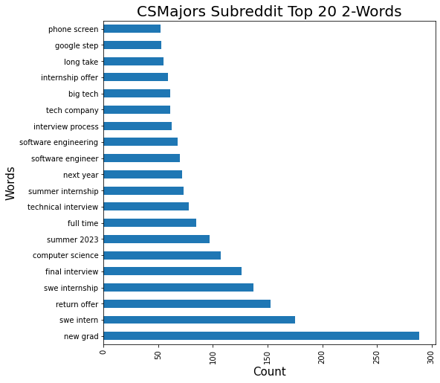
EDA : TOP 20 2-WORDs

Slide 26
EDA : TOP 20 2-WORDs - SIMILARITIES: CAREER

Slide 27
EDA : TOP 20 2-WORDs - DIFFERENCES: SCHOOLS VS INTERNSHIPS

Slide 28
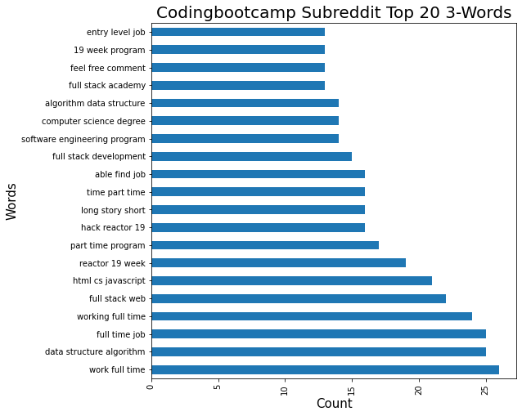
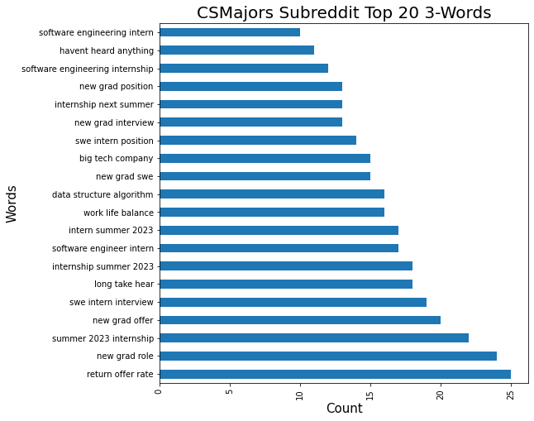
EDA : TOP 20 3-WORDs

Slide 29
EDA : TOP 20 3-WORDs - differences: full time job vs internship

Slide 30
EDA : TOP 20 3-WORDs - DIFFERENCES: TIME VS BALANCE

Slide 31
Modelling

Slide 32

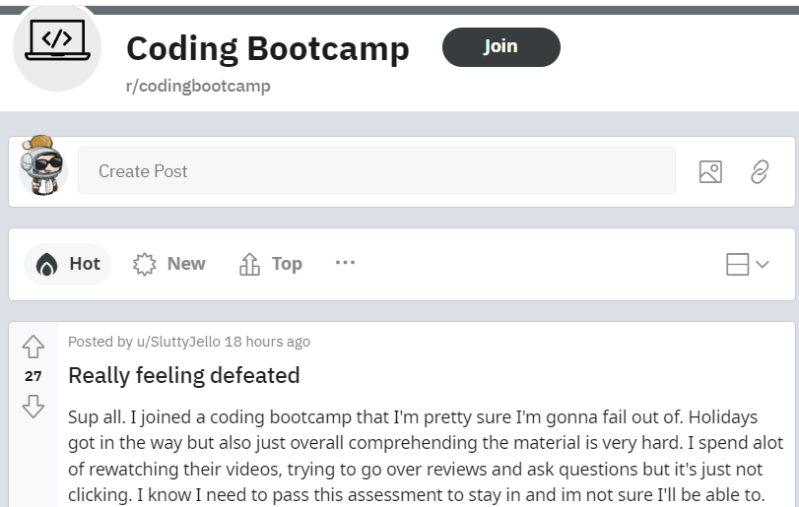


Purpose of model
Bootcamp Style
Reddit Posts
Model
>90% accuracy
4 years uni course
Notes:
Thank you mary-ann.
So our team’s aim is to create a model which is able to beat the baseline model’s accuracy of ~79%, and hitting at least a 90% accuracy in classifying and differentiating reddit users who are interested to join coding bootcamps from those who would like to take on a computer science degree.

Slide 33
Building a classification model
Data Preparation
Model Operation
Model Optimization
Converting text to numerical representation
Methods used:
Countvectorizer
N-grams
TF-IDF (Term Frequency-Inverse Document Frequency)
Classification model selection
Models used:
Bernoulli Naive Bayes
Multinomial Naive Bayes
Logistic Regression
Improving model accuracy
Optimization:
Hyperparameter tuning
Notes:
In order to build a classification model, our team created modelling pipelines, which involves the following linear sequence, starting with data preparation into model operation then finally model optimization.
Under data preparation, what we are actually doing is to use vectorization methods to convert text into numerical representation, so that our model can interpret the dataset.
There are 3 main methods of vectorization that were used, namely Countvectorization, N-grams, TF-IDF.
Next under model operation, the team ran through various classification models, to so as to select a model with the best performance. Some classification models used in the pipeline were Bernoulli Naive Bayes, Multinomial Naive Bayes, and Logistic regression models.
Finally in the last part of the pipeline, the team carried out model optimization through the use of hyperparameter tuning, to improve model performance.

Slide 34
MODEL SELECTIOn
Vectorization type | Classification Model | Train Accuracy score | Test Accuracy score
Baseline |  | 0.78039 | 0.78646
Countvectorizer | Bernoulli Naive Bayes | 0.84611 | 0.84215
Countvectorizer | Multinomial Naive Bayes | 0.93214 | 0.93149
Countvectorizer | Logistic Regression | 0.98678 | 0.93429
N-Gram* | Bernoulli Naive Bayes | 0.90435 | 0.86057
N-Gram* | Multinomial Naive Bayes | 0.98464 | 0.90545
N-Gram* | Logistic Regression | 0.94416 | 0.875
TF-IDF | Bernoulli Naive Bayes | 0.95698 | 0.92548
TF-IDF | Multinomial Naive Bayes | 0.95431 | 0.92748
TF-IDF | Logistic Regression | 0.96193 | 0.94231
*Only the best train-test result between Bi-Gram & Tri-Gram for the model is shown.
Notes:
So after running through various pipelines with different combination of vectorization methods and models, we compared and selected the pipeline with the best train-test accuracy score.
In this table, we can see that the baseline model which is uses straight-forward keywords such as ‘bootcamp’ and ‘coding’ to classify between the reddit posts, has a ~79% accuracy score on both train and test sets.
Out of all the pipelines that we ran, the combination of TF-IDF vectorization method and Logistic regression model had the train test accuracy score of 96% and 94%.

Slide 35
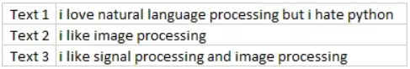
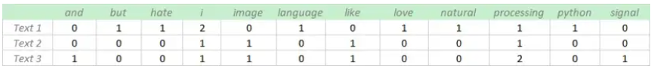
Term Frequency-Inverse Document Frequency (TF-IDF)
Vectorization method that penalizes terms that occur multiple times across different documents.
Notes:
So to further understand what what TF-IDF and logistic regression is.
TF-IDF, or Term Frequency-Inverse Document Frequency, is a vectorization method, so for this vectorization method, terms that occur multiple times across different documents, will be penalized and given a smaller weightage. So in this case, if you see from the example here, words like i and processing, occurs multiple times across all 3 texts, thus these words are given a smaller weightage and overall vectorization count.

Slide 36
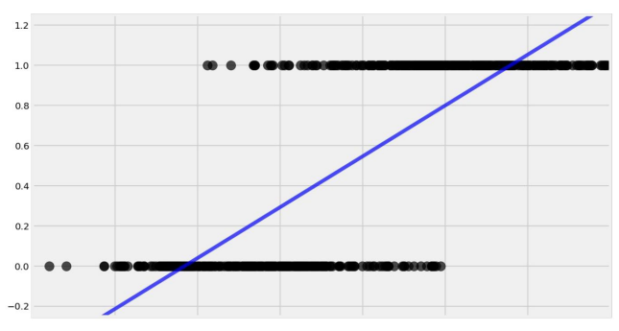
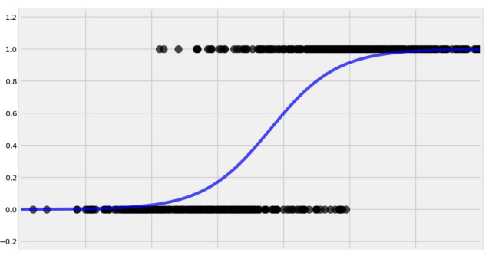
Logistic Regression Model
Logistic regression “bends” our best fit line, to match the range or set of values.
Useful in predicting binary outcomes.
Linear Regression
Logistic Regression
Notes:
For logistic regression modeling, what it does is, it bends our best fit line, to match the range or set of values. And it is useful in predicting binary outcomes, which is in our case is a suitable model, as it is used to differentiate between 2 categories.

Slide 37
Building a classification model
Data Preparation
Converting text to numerical representation
Methods used:
Countvectorizer
N-grams
TF-IDF (Term Frequency-Inverse Document Frequency)
Countvectorizer
Sentence: The Three Musketeers
 | The | Three | Musketeers
Sentence | 1 | 1 | 1
Notes:
Under data preparation, vectorization methods are used to convert text to numerical representation, so that our model can interpret the dataset.
There were 3 different methods used, 1st a countvectorizer.
The count vectorizer gives a count of each word that occurs in the entire text in the form of a vector. So for example, in the document list, the word “Geek” appears once in index [0], and once in index [3], and none in index[2] So the count records the count.

Slide 38
Building a classification model
Data Preparation
Bi-gram
Sentence: The Three Musketeers
Converting text to numerical representation
Methods used:
Countvectorizer
N-grams
TF-IDF (Term Frequency-Inverse Document Frequency)
 | The Three | Three Musketeers
Sentence | 1 | 1
Tri-gram
Sentence: The Three Musketeers
 | The Three Musketeers
Sentence | 1
Notes:
In the case of N-grams, counts are given for a group of consecutive words depending on the type of N-gram. So for example for a Bi-gram, words that are side by side will be given a count. For this sentence “the Three musketeers”, “the Three” and “three Musketeers” will be counted. For a tri-gram, 3 consecutive words will be grouped and counted.

Slide 39
Bernoulli/ Model
Logistic regression “bends” our best fit line, to match the range or set of values.
Useful in predicting binary outcomes.
Linear Regression
Logistic Regression
Notes:
Bernoulli Naive Bayes: most suitable when we have 0/1 variables.
Multinomial Naive Bayes: most suitable when our variables are positive integers.
Assumes that our X features are completely independent of each other.

Slide 40
Model Optimization
Vectorization + Model Type | Parameters Optimized | Improvement
TF-IDF + Logistic Regression | max features min_df max_df lg_solver | ~0.04%
Notes:
So in the last portion of our pipeline, we went through model optimization, whereby hyperparameter tuning was done for max features, min_df, max_df and logistic solver type. However, from these parameters, there was an overall improvement of 0.04% from the optimization. So this an area which, with more time, we could look into optimizing other parameters.
min_df : a limit which the model will ignore keywords with a document frequency below the set limit

Slide 41
Model Evaluation
Notes:
So apart from just looking at model accuracy, we have other method of evaluating our model;s performance

Slide 42
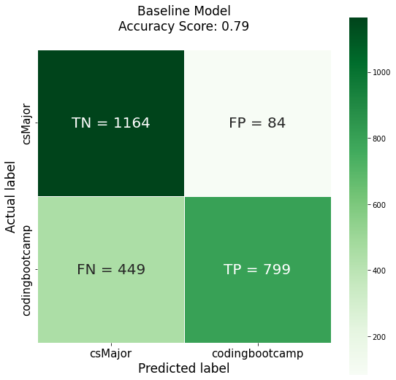
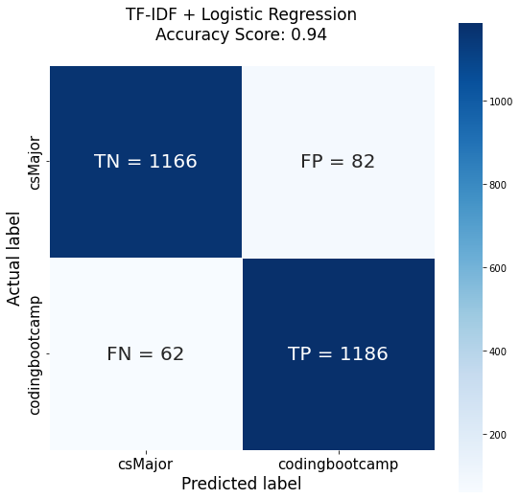
Confusion Matrix - higher accuracy for model
Positive class: codingbootcamp, Negative class: csMajor.
TN: True Negative, TP: True Positive → Predictions are correct, for either classes
FN: False Negative, FP: False Positive → Predictions are wrong, for either classes
Accuracy = True Predictions / Total Predictions.
Notes:
So as we have seen before, our TF-IDF model accuracy is ~94%, while our baseline model accuracy is 79%. These accuracy figures can also be calculated through a confusion matrix.
The confusion matrix comprises of are 4 boxes, so if you go clockwise, you will see the number of True negative, False Positive, True Positive, and False negative cases. So in our context, Positive class refers to codingbootcamp category, while negative class refers to to csMajors. So what True negative and True positive points to, are the cases where the predictions by the model are correct, for either classes. While False negative and False positive points to wrong predictions by the model for either classes.
So to calculate accuracy, we can take the total True predictions over total predictions. So total true predictions will be taking the values from the highlight red boxes, and total prediction will be the total number of cases. As the number of True positive cases for our model is higher - 1186 vs 799, it translates to a better accuracy score for our model.

Slide 43
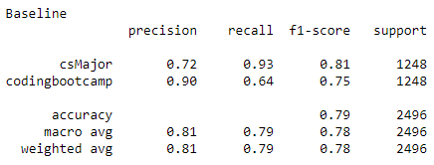
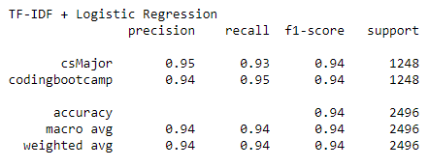
Classification Report - higher f1-score
TF-IDF + Logistic Regression
Baseline
Precision = TP / (TP + FP)
Recall = TP / (TP + FN)
F1-Score = Weighted Average of Precision and Recall
Better the model if F1-score is closer to 1.
Notes:
From the confusion matrix, we can further calculate the precision, recall, f1-scores, which are other factors which offers us a better overall measure of the model’s performance on top of accuracy.
Precision: Percentage of true positive predictions relative to total positive predictions.
Recall: Percentage of true positive predictions relative to total actual positives.
F1 Score: A weighted average of precision and recall. The closer to 1, the better the model.
Thus, we can see that F1-scores for our model is 94%, which is a stark improvement from our baseline model.

Slide 44
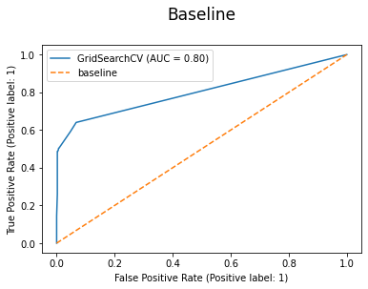
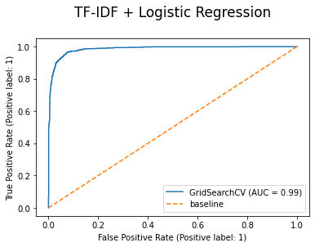
roc curve - higher AUC SCore
Receiver Operating Characteristic Curve (ROC)
Area Under the Curve (AUC): Indicative of model classification performance
AUC = 0.98558
AUC = 0.80200
Higher AUC score Better differentiation between categories
Notes:
Another feature which helps us to evaluate our model’s classification performance, is the ROC curve. So the ROC curve or the Receiver Operating Characteristic Curve, plots the True Positive Rate against the False positive rate. The Area under the ROC curve gives us an idea of how well the model does in terms of predicting or classifying the reddit cases. Thus in this case, we can see on the left, that the AUC is ~0.8 for the baseline model, while the TF-IDF + logistic regression model has an AUC of ~0.99. Hence there is a big improvement in terms of performance on differentiating and classifying which sub-reddit category the post belongs to.
TPR = TP/(TP+FN) - actual positive cases
FPR = FP/(FP+TN) - actual negative cases
Thus based on the few model evaluation methods, our new model outperforms the current baseline model in each of the model evaluation method, and has a overall accuracy of ~94%, which meets our target of having a model with more than 90% accuracy.
Next i will hand over to shawn, he will be providing our recommendations and concluding our presentation.

Slide 45







MOVING FORWARD
Time & resources
Web lingo
Sentiment analysis
Gather more data to train the model, using information from various platforms
Train the model to better understand acronyms and abbreviations being used
Expand the model to understand the sentiments behind the posts
Notes:
Cover more online platforms that GA may be present in to better refine our model.
Expand our model to cover more areas outside of CS, e.g. UX/UI design
While readily available and easy to scrape, Reddit posts are mostly from US based users, so may not be as ideal for deployment in other markets
Better labelling and grouping to help the model better understand web lingo
For example, SWE appears often, but this is also a duplicate with software engineer, so potentially these terms could be grouped together for our model
Sentiment analysis could allow us to determine whether the user is positive or negative regarding the post. This may also have some correlation to the possible conversion of the user.

Slide 46
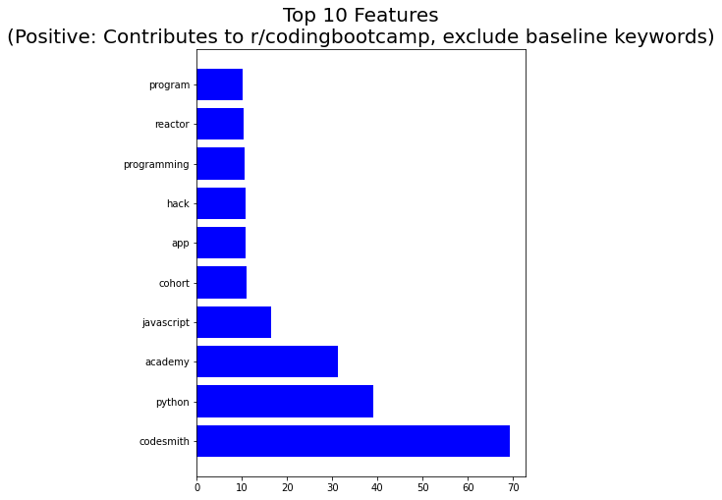
Skill related features that we can focus on based on courses offered at General Assembly
Notes:
Data Analytics Immersive
Data Science Immersive
Software Engineering Immersive
UX Design Immersive
Front-End Web Development
Product Management

Slide 47



Competitors are mentioned more frequently on Reddit
Creates opportunity for GA to market towards these users
Notes:
Codesmith: Top Ranked Coding School in NYC, LA & Online
Hack Reactor is one of the top coding bootcamps and we select high-potential students through a rigorous admissions process.
App Academy: Software Engineering Coding Bootcamp
Often a first mover market,

Slide 48
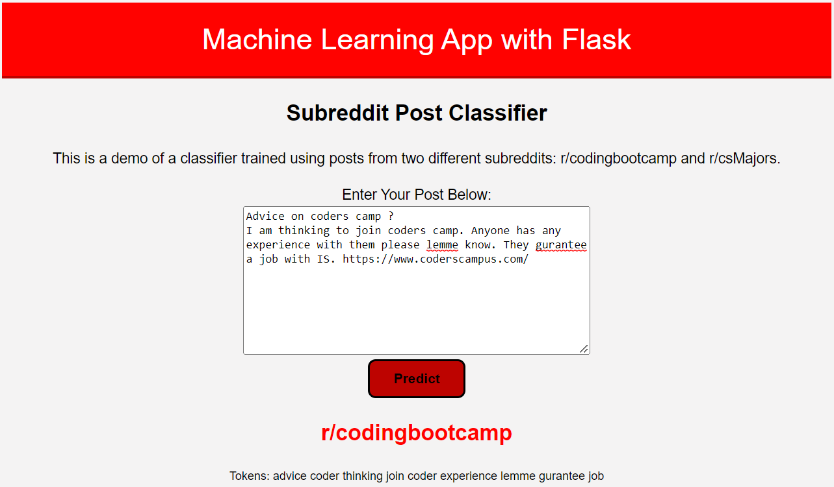
Sample predictions

Slide 49
Recommendations
keywords
Automation
marketing
Features produced by our model will allow the team to better identify suitable posts to engage with.
Deployment of the model to automatically scan our social media interactions.
Boost marketing across channels to increase visibility compared with our competitors.

Slide 50
Conclusion
01.
02.
Increasing visibility and response
GA needs to stand out from our competitors and speed is also essential in being able to act before our competitors.
Segmenting and targeting the right audience
Maximise our marketing ROI and increase our conversion rate.

Slide 51
THANK you
Please keep this slide for attribution

